Slide 1
Query Operations; Relevance Feedback; and Personalization
CSC 575
Intelligent Information Retrieval

Slide 2
Topics
Query Expansion
Thesaurus based
Automatic global and local analysis
Relevance Feedback via Query modification
Information Filtering through Personalization
Collaborative Filtering
Content-Based Filtering
Social Recommendation
Interface Agents and Agents for Information Filtering

Slide 3
Thesaurus-Based Query Expansion
For each term, t, in a query, expand the query with synonyms and related words of t from the thesaurus.
May weight added terms less than original query terms.
Generally increases recall.
May significantly decrease precision, particularly with ambiguous terms.
“interest rate” → “interest rate fascinate evaluate”
WordNet
A more detailed database of semantic relationships between English words.
Developed by famous cognitive psychologist George Miller and a team at Princeton University.
About 144,000 English words.
Nouns, adjectives, verbs, and adverbs grouped into about 109,000 synonym sets called synsets.

Slide 4
WordNet Synset Relationships
Antonym: front → back
Attribute: benevolence → good (noun to adjective)
Pertainym: alphabetical → alphabet (adjective to noun)
Similar: unquestioning → absolute
Cause: kill → die
Entailment: breathe → inhale
Holonym: chapter → text (part-of)
Meronym: computer → cpu (whole-of)
Hyponym: tree → plant (specialization)
Hypernym: fruit → apple (generalization)
WordNet Query Expansion
Add synonyms in the same synset.
Add hyponyms to add specialized terms.
Add hypernyms to generalize a query.
Add other related terms to expand query.

Slide 5
Statistical Thesaurus
Problems with human-developed thesauri
Existing ones are not easily available in all languages.
Human thesuari are limited in the type and range of synonymy and semantic relations they represent.
Semantically related terms can be discovered from statistical analysis of corpora.
Automatic Global Analysis
Determine term similarity through a pre-computed statistical analysis of the complete corpus.
Compute association matrices which quantify term correlations in terms of how frequently they co-occur.
Expand queries with statistically most similar terms.

Slide 6
Association Matrix
w₁ w₂ w₃ …………………..w_{n}
w₁
w₂
w₃
.
.
w_{n}
c₁₁ c₁₂ c₁₃…………………c_{1n}
c_{ij}: Correlation factor between
term i and term j
c₂₁
c₃₁
.
.
c_{n1}
f_{ik} : Frequency of term i in document k
Above frequency based correlation factor favors more frequent terms.
Solutions: Normalize association scores:
Normalized score is 1 if two terms have the same frequency in all documents.

Slide 7
Metric Correlation Matrix
Association correlation does not account for the proximity of terms in documents, just co-occurrence frequencies within documents.
Metric correlations account for term proximity.
Can also normalize scores to account for term frequencies:
V_{i}: Set of all occurrences of term i in any document.
r(k_{u},k_{v}): Distance in words between word occurrences k_{u} and k_{v}
(∞ if k_{u} and k_{v} are occurrences in different documents).

Slide 8
Query Expansion with Correlation Matrix
For each term i in query,
expand query with the n terms, j, with the highest value of c_{ij} (s_{ij}).
This adds semantically related terms in the “neighborhood” of the query terms.
Problems with Global Analysis
Term ambiguity may introduce irrelevant statistically correlated terms.
“Apple computer” → “Apple red fruit computer”
Since terms are highly correlated anyway, expansion may not retrieve many additional documents.

Slide 9
Automatic Local Analysis
At query time, dynamically determine similar terms based on analysis of top-ranked retrieved documents.
Base correlation analysis on only the “local” set of retrieved documents for a specific query.
Avoids ambiguity by determining similar (correlated) terms only within relevant documents.
“Apple computer” → “Apple computer Powerbook laptop”
Global vs. Local Analysis
Global analysis requires intensive term correlation computation only once at system development time.
Local analysis requires intensive term correlation computation for every query at run time (although number of terms and documents is less than in global analysis).
But local analysis gives better results.

Slide 10
Global Analysis Refinements
Only expand query with terms that are similar to all terms in the query.
“fruit” not added to “Apple computer” since it is far from “computer.”
“fruit” added to “apple pie” since “fruit” close to both “apple” and “pie.”
Use more sophisticated term weights (instead of just frequency) when computing term correlations.

Slide 11
Query Modification & Relevance Feedback
Problem: how to reformulate the query?
Thesaurus expansion:
Suggest terms similar to query terms (e.g., synonyms)
Relevance feedback:
Suggest terms (and documents) similar to retrieved documents that have been judged (by the user) to be relevant
Relevance Feedback
Modify existing query based on relevance judgements
extract terms from relevant documents and add them to the query
and/or re-weight the terms already in the query
usually positive weights for terms from relevant docs
sometimes negative weights for terms from non-relevant docs
Two main approaches:
Automatic (psuedo-relevance feedback)
Users select relevant documents

Slide 12
Lexical analysis and stop words
Information
need
Collections
Pre-process
text input
Parse
Query
Index
Term Selection and
Weighting
Reformulated
Query
Rank
Matching / ranking algorithms
Relevance
Feedback
Result
Sets

Slide 13
Query Reformulation in Vector Space Model
Change query vector using vector algebra.
Add the vectors for the relevant documents to the query vector.
Subtract the vectors for the irrelevant docs from the query vector.
This both adds both positive and negatively weighted terms to the query as well as reweighting the initial terms.

Slide 14
Rocchio’s Method (1971)

Slide 15
Rocchio’s Method
Rocchio’s Method automatically
re-weights terms
adds in new terms (from relevant docs)
Positive v. Negative feedback
Positive moves query closer to relevant documents
Negative moves query away from non-relevant documents (but, not necessary closer to relevant ones)
negative feedback doesn’t always improve effectiveness
some systems only use positive feedback
Some machine learning methods are proving to work better than standard IR approaches like Rocchio
Positive Feedback
Negative Feedback

Slide 16
Rocchio’s Method: Example
Term weights and relevance judgements for 3 documents returned after submitting the query Q₀
Assume β = 0.5 and γ = 0.25
Q₁ = (3, 0, 0, 2, 0) + 0.25*(2+1, 4+3, 0, 0, 2) - 0.25*(0, 0, 4, 3, 2)
= (3.75, 1.75, 0, 1.25, 0)
(Note: negative entries are changed to zero)

Slide 17
Rocchio’s Method: Example
Q₀ = (3, 0, 0, 2, 0)
Q₁ = (3.75, 1.75, 0, 1.25, 0)
Using the new query and computing similarities using
simple matching function, gives the following results
Some Observations:
Note that initial query resulted in high score for D3, though it was not relevant to the user (due to the weight of term 4)
In general, fewer terms in the query, the more likely a particular term could result in non-relevant results
New query decreased score of D3 and increased those of D1 and D2
Also note that new query added a weight for term 2
Initially it may not have been in user’s vocabulary
It was added because it appeared as significant in enough relevant documents

Slide 18
A User Study of Relevance Feedback Koenemann & Belkin 96
Main questions in the study:
How well do users work with statistical ranking on full text?
Does relevance feedback improve results?
Is user control over operation of relevance feedback helpful?
How do different levels of user control effect results?
How much of the details should the user see?
Opaque (black box)
(like web search engines)
Transparent
(see all available terms)
Penetrable
(see suggested terms before the relevance feedback)
Which do you think worked best?

Slide 19
Details of the User Study Koenemann & Belkin 96
64 novice searchers
43 female, 21 male, native English speakers
TREC test bed
Wall Street Journal subset
Two search topics
Automobile Recalls
Tobacco Advertising and the Young
Relevance judgements from TREC and experimenter
System was INQUERY (vector space with some bells and whistles)
Goal was for users to keep modifying the query until they get one that gets high precision
They did not reweight query terms
Instead, only term expansion

Slide 20
Experiment Results Koenemann & Belkin 96
Effectiveness Results
Subjects with r.f. did 17-34% better performance than no r.f.
Subjects with penetration case did 15% better as a group than those in opaque and transparent cases
Behavior Results
Search times approximately equal
Precision increased in first few iterations
Penetration case required fewer iterations to make a good query than transparent and opaque
R.F. queries much longer
but fewer terms in penetration case -- users were more selective about which terms were added in.

Slide 21
Relevance Feedback Summary
Iterative query modification can improve precision and recall for a standing query
TREC results using SMART have shown consistent improvement
Effects of negative feedback are not always predictable
In at least one study, users were able to make good choices by seeing which terms were suggested for r.f. and selecting among them
So … “more like this” can be useful!
Exercise: Which of the major Web search engines provide relevance feedback? Do a comparative evaluation

Slide 22
Pseudo Feedback
Use relevance feedback methods without explicit user input.
Just assume the top m retrieved documents are relevant, and use them to reformulate the query.
Allows for query expansion that includes terms that are correlated with the query terms.
Found to improve performance on TREC competition ad-hoc retrieval task.
Works even better if top documents must also satisfy additional Boolean constraints in order to be used in feedback.

Slide 23
Alternative Notions of Relevance Feedback
With advent of WWW, many alternate notions have been proposed
Find people “similar” to you. Will you like what they like?
Follow the users’ actions in the background. Can this be used to predict what the user will want to see next?
Follow what lots of people are doing. Does this implicitly indicate what they think is good or not good?
Several different criteria to consider:
Implicit vs. Explicit judgements
Individual vs. Group judgements
Standing vs. Dynamic topics
Similarity of the items being judged vs. similarity of the judges themselves

Slide 24
Collaborative Filtering
“Social Learning”
idea is to give recommendations to a user based on the “ratings” of objects by other users
usually assumes that features in the data are similar objects (e.g., Web pages, music, movies, etc.)
usually requires “explicit” ratings of objects by users based on a rating scale
there have been some attempts to obtain ratings implicitly based on user behavior (mixed results; problem is that implicit ratings are often binary)
Will Karen like “Independence Day?”

Slide 25

Collaborative Recommender Systems

Slide 26

Collaborative Recommender Systems

Slide 27

Collaborative Recommender Systems

Slide 28
Collaborative Filtering: Nearest-Neighbor Strategy
Basic Idea:
find other users that are most similar preferences or tastes to the target user
Need a metric to compute similarities among users (usually based on their ratings of items)
Pearson Correlation
weight by degree of correlation between user U and user J
1 means very similar, 0 means no correlation, -1 means dissimilar
Average rating of user J
on all items.

Slide 29
Collaborative Filtering: Making Predictions
When generating predictions from the nearest neighbors, neighbors can be weighted based on their distance to the target user
To generate predictions for a target user a on an item i:
r_{a} = mean rating for user a
u₁, …, u_{k} are the k-nearest-neighbors to a
r_{u,i} = rating of user u on item I
sim(a,u) = Pearson correlation between a and u
This is a weighted average of deviations from the neighbors’ mean ratings (and closer neighbors count more)

Slide 30
Distance or Similarity Measures
Pearson Correlation
Works well in case of user ratings (where there is at least a range of 1-5)
Not always possible (in some situations we may only have implicit binary values, e.g., whether a user did or did not select a document)
Alternatively, a variety of distance or similarity measures can be used
Common Distance Measures:
Manhattan distance:
Euclidean distance:
Cosine similarity:

Slide 31
Example Collaborative System
 | Item1 | Item 2 | Item 3 | Item 4 | Item 5 | Item 6 | Correlation with Alice
Alice | 5 | 2 | 3 | 3 |  | ?
User 1 | 2 |  | 4 |  | 4 | 1 | -1.00
User 2 | 2 | 1 | 3 |  | 1 | 2 | 0.33
User 3 | 4 | 2 | 3 | 2 |  | 1 | .90
User 4 | 3 | 3 | 2 |  | 3 | 1 | 0.19
User 5 |  | 3 |  | 2 | 2 | 2 | -1.00
User 6 | 5 | 3 |  | 1 | 3 | 2 | 0.65
User 7 |  | 5 |  | 1 | 5 | 1 | -1.00
Prediction

Best match
Using k-nearest neighbor with k = 1

Slide 32
Item-based Collaborative Filtering
Find similarities among the items based on ratings across users
Often measured based on a variation of Cosine measure
Prediction of item I for user a is based on the past ratings of user a on items similar to i.
Suppose:
Predicted rating for Karen on Indep. Day will be 7, because she rated Star Wars 7
That is if we only use the most similar item
Otherwise, we can use the k-most similar items and again use a weighted average
sim(Star Wars, Indep. Day) > sim(Jur. Park, Indep. Day) > sim(Termin., Indep. Day)

Slide 33
Item-Based Collaborative Filtering
Prediction

 | Item1 | Item 2 | Item 3 | Item 4 | Item 5 | Item 6
Alice | 5 | 2 | 3 | 3 |  | ?
User 1 | 2 |  | 4 |  | 4 | 1
User 2 | 2 | 1 | 3 |  | 1 | 2
User 3 | 4 | 2 | 3 | 2 |  | 1
User 4 | 3 | 3 | 2 |  | 3 | 1
User 5 |  | 3 |  | 2 | 2 | 2
User 6 | 5 | 3 |  | 1 | 3 | 2
User 7 |  | 5 |  | 1 | 5 | 1
Item similarity | 0.76 | 0.79 | 0.60 | 0.71 | 0.75
Best match
Cosine Similarity to the target item

Slide 34
Collaborative Filtering: Pros & Cons
Advantages
Ignores the content, only looks at who judges things similarly
If Pam liked the paper, I’ll like the paper
If you liked Star Wars, you’ll like Independence Day
Rating based on ratings of similar people
Works well on data relating to “taste”
Something that people are good at predicting about each other too
can be combined with meta information about objects to increase accuracy
Disadvantages
early ratings by users can bias ratings of future users
small number of users relative to number of items may result in poor performance
scalability problems: as number of users increase, nearest neighbor calculations become computationally intensive
because of the (dynamic) nature of the application, it is difficult to select only a portion instances as the training set.

Slide 35
Content-based recommendation
Collaborative filtering does NOT require any information about the items,
However, it might be reasonable to exploit such information
E.g. recommend fantasy novels to people who liked fantasy novels in the past
What do we need:
Some information about the available items such as the genre ("content")
Some sort of user profile describing what the user likes (the preferences)
The task:
Learn user preferences
Locate/recommend items that are "similar" to the user preferences

Slide 36






Content-Based Recommenders
Predictions for unseen (target) items are computed based on their similarity (in terms of content) to items in the user profile.
E.g., user profile P_{u} contains
recommend highly: and recommend “mildly”:

Slide 37
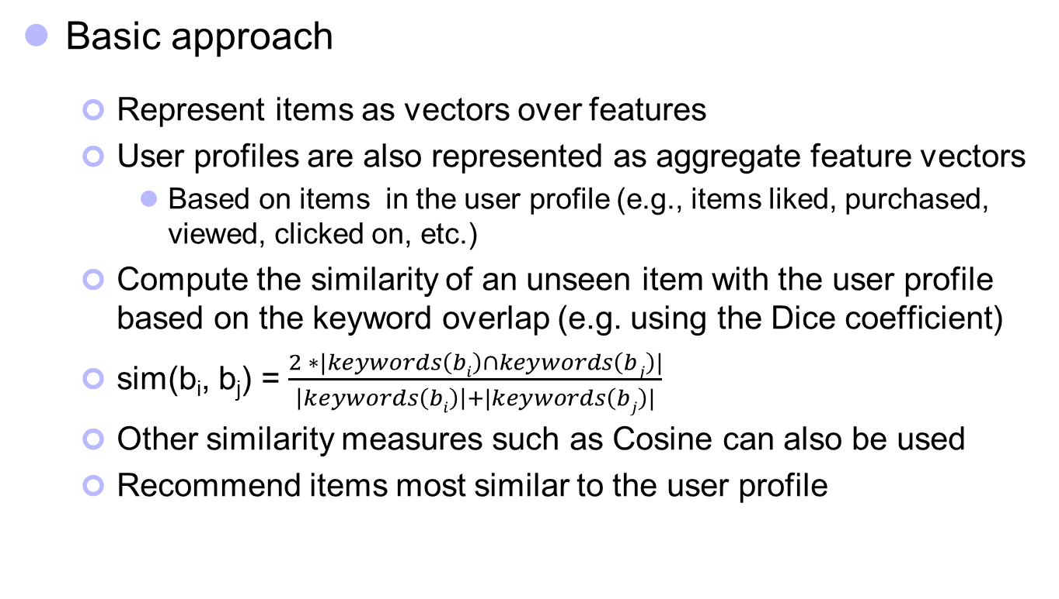
Content-based recommendation
Basic approach
Represent items as vectors over features
User profiles are also represented as aggregate feature vectors
Based on items in the user profile (e.g., items liked, purchased, viewed, clicked on, etc.)
Compute the similarity of an unseen item with the user profile based on the keyword overlap (e.g. using the Dice coefficient)
sim(b_{i}, b_{j}) = $\frac{2 ∗|keywords\left(bi\right)∩keywords\left(bj\right)|}{\left|keywords\left(bi\right)\right|+|keywords\left(bj\right)|}$
Other similarity measures such as Cosine can also be used
Recommend items most similar to the user profile
Notes:
Intersection

Slide 38
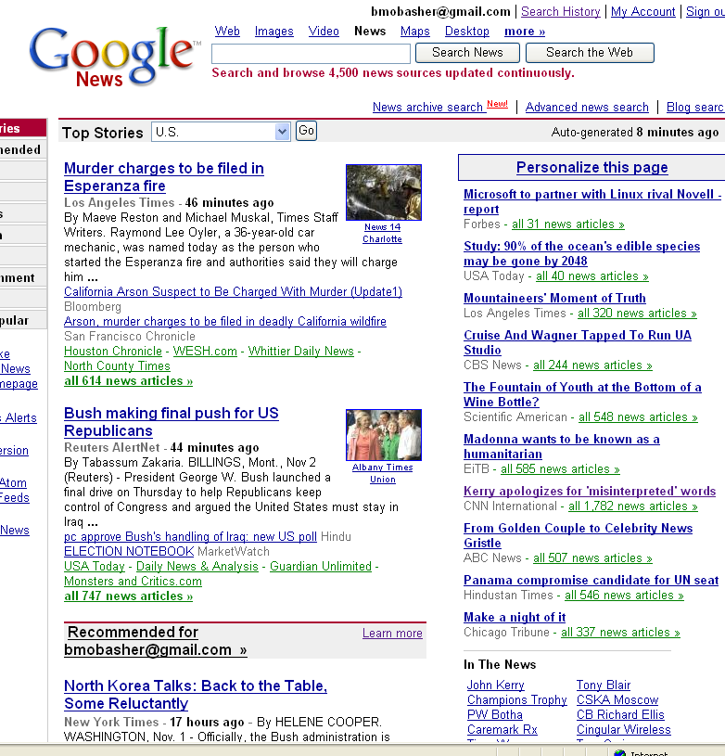
Content-Based Recommender Systems

Slide 39

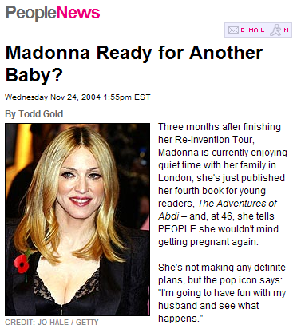
Content-Based Recommenders: Personalized Search
How can the search engine determine the “user’s context”?
?
Query: “Madonna and Child”
?
Need to “learn” the user profile:
User is an art historian?
User is a pop music fan?

Slide 40
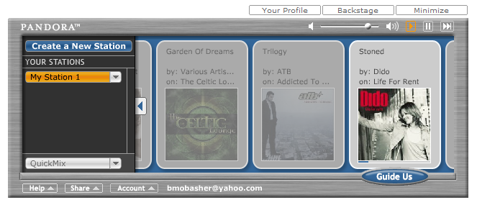
Content-Based Recommenders
Music recommendations
Play list generation
Example: Pandora

Slide 41
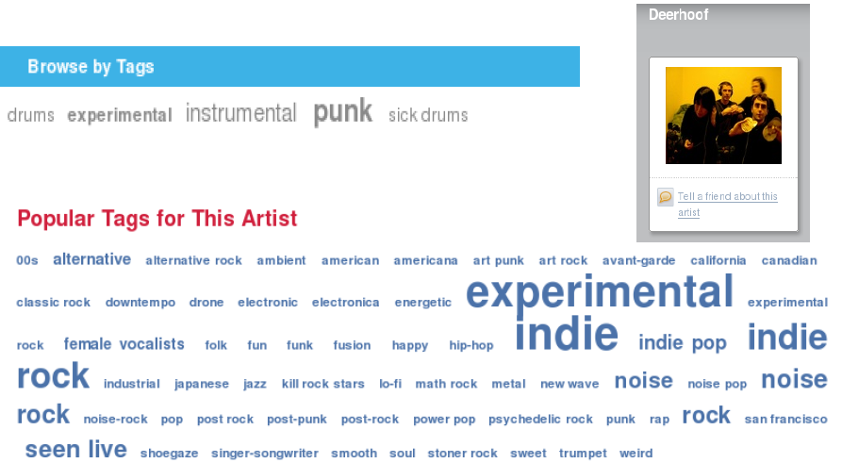
Social / Collaborative Tags

Slide 42
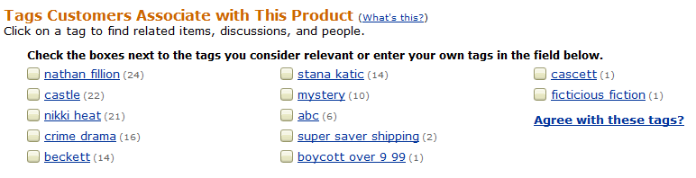

Example: Tags describe the Resource
Tags can describe
The resource (genre, actors, etc)
Organizational (toRead)
Subjective (awesome)
Ownership (abc)
etc

Slide 43
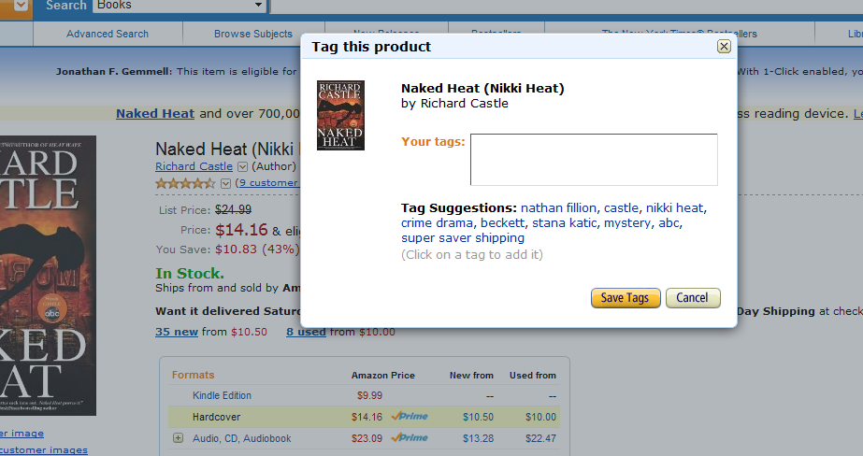
Tag Recommendation

Slide 44
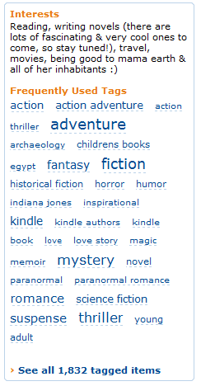


Tags describe the user
These systems are “collaborative.”
Recommendation / Analytics based on the “wisdom of crowds.”
Rai Aren's profile
co-author
“Secret of the Sands"

Slide 45

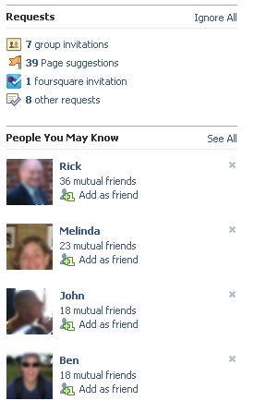
Social Recommendation
A form of collaborative filtering using social network data
Users profiles represented as sets of links to other nodes (users or items) in the network
Prediction problem: infer a currently non-existent link in the network

Slide 46
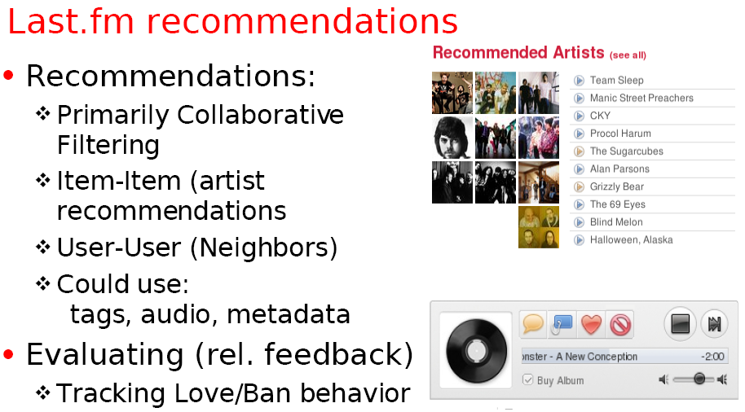
Example: Using Tags for Recommendation

Slide 47
Learning interface agents
Add agents to the user interface and delegate tasks to them
Use machine learning to improve performance
learn user behavior, preferences
Useful when:
1) past behavior is a useful predictor of the future behavior
2) wide variety of behaviors amongst users
Examples:
mail clerk: sort incoming messages in right mailboxes
calendar manager: automatically schedule meeting times?
Personal news agents
portfolio manager agents
Advantages:
less work for user and application writer
adaptive behavior
user and agent build trust relationship gradually

Slide 48
Letizia: Autonomous Interface Agent (Lieberman 96)
user
letizia
heuristics
recommendations
user profile
Recommends web pages during browsing based on user profile
Learns user profile using simple heuristics
Passive observation, recommend on request
Provides relative ordering of link interestingness
Assumes recommendations “near” current page are more valuable than others

Slide 49
Letizia: Autonomous Interface Agent
Infers user preferences from behavior
Interesting pages
record in hot list (save as a file)
follow several links from pages
returning several times to a document
Not Interesting
spend a short time on document
return to previous document without following links
passing over a link to document (selecting links above and below document)
Why is this useful
tracks and learns user behavior, provides user “context” to the application (browsing)
completely passive: no work for the user
useful when user doesn’t know where to go
no modifications to application: Letizia interposes between the Web and browser

Slide 50
Consequences of passiveness
Weak heuristics
example: click through multiple uninteresting pages en route to interestingness
example: user browses to uninteresting page, then goes for a coffee
example: hierarchies tend to get more hits near root
Cold start
No ability to fine tune profile or express interest without visiting “appropriate” pages
Some possible alternative/extensions to internally maintained profiles:
expose to the user (e.g. fine tune profile) ?
expose to other users/agents (e.g. collaborative filtering)?
expose to web server (e.g. cnn.com custom news)?

Slide 51
ARCH: Adaptive Agent for Retrieval Based on Concept Hierarchies (Mobasher, Sieg, Burke 2003-2007)
ARCH supports users in formulating effective search queries starting with users’ poorly designed keyword queries
Essence of the system is to incorporate domain-specific concept hierarchies with interactive query formulation
Query enhancement in ARCH uses two mutually-supporting techniques:
Semantic – using a concept hierarchy to interactively disambiguate and expand queries
Behavioral – observing user’s past browsing behavior for user profiling and automatic query enhancement

Slide 52
Overview of ARCH
The system consists of an offline and an online component
Offline component:
Handles the learning of the concept hierarchy
Handles the learning of the user profiles
Online component:
Displays the concept hierarchy to the user
Allows the user to select/deselect nodes
Generates the enhanced query based on the user’s interaction with the concept hierarchy

Slide 53
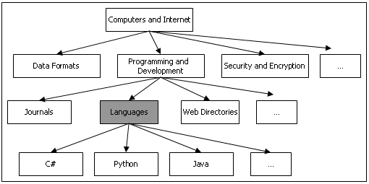
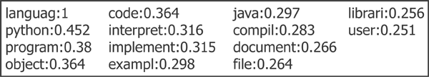
Offline Component - Learning the Concept Hierarchy
Maintain aggregate representation of the concept hierarchy
pre-compute the term vectors for each node in the hierarchy
Concept classification hierarchy - Yahoo

Slide 54
Aggregate Representation of Nodes in the Hierarchy
A node is represented as a weighted term vector:
centroid of all documents and subcategories indexed under the node
n = node in the concept hierarchy
D_{n} = collection of individual documents
S_{n} = subcategories under n
T_{d} = weighted term vector for document d indexed under node n
T_{s} = the term vector for subcategory s of node n

Slide 55
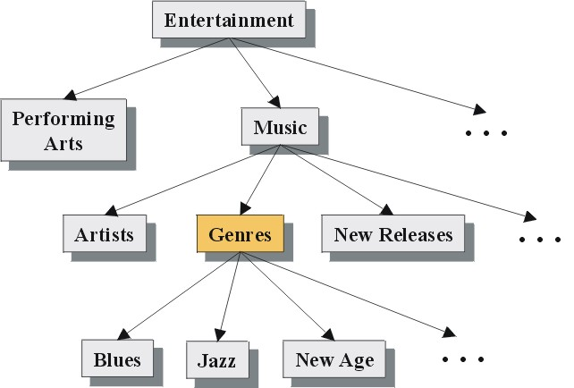
Example from Yahoo Hierarchy

Slide 56
Online Component – User Interaction with Hierarchy
The initial user query is mapped to the relevant portions of hierarchy
user enters a keyword query
system matches the term vectors representing each node in the hierarchy with the keyword query
nodes which exceed a similarity threshold are displayed to the user, along with other adjacent nodes.
Semi-automatic derivation of user context
ambiguous keyword might cause the system to display several different portions of the hierarchy
user selects categories which are relevant to the intended query, and deselects categories which are not

Slide 57
Generating the Enhanced Query
Based on an adaptation of Rocchio's method for relevance feedback
Using the selected and deselected nodes, the system produces a refined query Q₂:
each T_{sel} is a term vector for one of the nodes selected by the user,
each T_{desel} is a term vector for one of the deselected nodes
factors α, β, and γ are tuning parameters representing the relative weights associated with the initial query, positive feedback, and negative feedback, respectively such that α + β - γ = 1.

Slide 58
An Example
+
Music
Initial Query
“music, jazz”
Selected Categories
Artists
Genres
New Releases
“Music”, “jazz”, “Dixieland”
-
. . .
Deselected Category
Blues
+
Jazz
New Age
“Blues”
+
Dixieland
. . .
Portion of the resulting term vector:
music: 1.00, jazz: 0.44, dixieland: 0.20, tradition: 0.11,
band: 0.10, inform: 0.10, new: 0.07, artist: 0.06

Slide 59
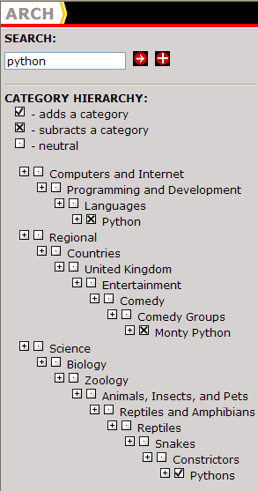
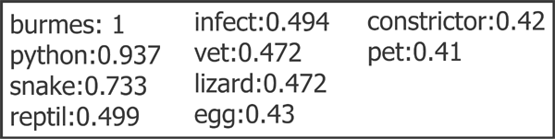
Another Example – ARCH Interface
Initial query = python
Intent for search = python as a snake
User selects Pythons under Reptiles
User deselects Python under Programming and Development and Monty Python under Entertainment
Enhanced query:

Slide 60
Generation of User Profiles
Profile Generation Component of ARCH
passively observe user’s browsing behavior
use heuristics to determine which pages user finds “interesting”
time spent on the page (or similar pages)
frequency of visit to the page or the site
other factors, e.g., bookmarking a page, etc.
implemented as a client-side proxy server
Clustering of “Interesting” Documents
ARCH extracts feature vectors for each profile document
documents are clustered into semantically related categories
we use a clustering algorithm that supports overlapping categories to capture relationships across clusters
algorithms: overlapping version of k-means; hypergraph partitioning
profiles are the significant features in the centroid of each cluster

Slide 61
User Profiles & Information Context
Can user profiles replace the need for user interaction?
Instead of explicit user feedback, the user profiles are used for the selection and deselection of concepts
Each individual profile is compared to the original user query for similarity
Those profiles which satisfy a similarity threshold are then compared to the matching nodes in the concept hierarchy
matching nodes include those that exceeded a similarity threshold when compared to the user’s original keyword query.
The node with the highest similarity score is used for automatic selection; nodes with relatively low similarity scores are used for automatic deselection

Slide 62
Results Based on User Profiles

